Slide 1
Emotion Recognition
Using different Deep Learning Techniques

Slide 2
Presentation Outline
01
02
03
Introduction
Problem Statement
Dataset Description
04
Dataset Preprocessing
05
06
Data Augmentation
Label Balancing
Pre Trained Models
07
08
Training Model
09
Comparison of Model

Slide 3



Introduction

Slide 4

Introduction
Emotion recognition is the process of identifying human emotions from facial expressions.
It has many applications, including marketing, healthcare, education, and security.
One popular dataset for emotion recognition is the EMOTIC dataset, which contains over 24,000 images labeled with 26 emotions.
In this project, we will build a deep learning model to classify emotions in the EMOTIC dataset using pre-trained models and transfer learning techniques.
The purpose of this presentation is to demonstrate how to use pre-trained deep learning models to classify emotions in the EMOTIC dataset and compare their performance with different optimizers.

Slide 5
Problem Statement
The problem statement for the emotion recognition task is to accurately identify the emotion expressed in a given image using machine learning algorithms.

Slide 6
Challenges
The challenges associated with this task include:
Variability in human emotions: Human emotions can be complex and subtle, making it difficult to accurately capture and represent them in a dataset.
Ambiguity in facial expressions: Facial expressions can be ambiguous, with the same expression potentially representing different emotions in different contexts.
Limited availability of labeled data: Emotion recognition datasets are relatively small and may not fully capture the diversity of emotions expressed in real-world scenarios.

Slide 7
Project Goal
The goals of the project are to:
Train and evaluate deep learning models for emotion recognition using the EMOTIC dataset.
Compare the performance of different pre-trained models and optimizers on this task.
Generate insights into the strengths and limitations of current emotion recognition methods.

Slide 8
Dataset Description

Slide 9
EMOTIC Dataset
EMOTIC dataset is a collection of images of people in unconstrained environments annotated according to their apparent emotional states.
This dataset can accessed by taking permission from the Emotic Dataset Contributor from their Emotic Set.
This Dataset comprises of images from COCO and Ade20k public benchmark datasets.
The Dataset is annotated using Amazon Mechanical Turk (AMT)

Slide 10
EMOTIC Dataset
There are 26 Emotion in Dataset which annotated using AMT.
The Emotions are:
Embarrassment
Engagement
Esteem
Excitement
Fatigue
Fear
Happiness
Pain
Peace
Pleasure
Affection
Anger
Annoyance
Anticipation
Aversion
Confidence
Disapproval
Disconnection
Disquietment
Doubt
Sadness
Sensitivity
Suffering
Surprise
Sympathy
Yearning

Slide 11
Data Preprocessing

Slide 12
Data Preprocessing
Data preprocessing is an important step in any machine learning project, and it involves transforming raw data into a format that can be used by the model.
The following are the steps involved in preprocessing the EMOTIC dataset:
01
02
Image Resizing
The images in the EMOTIC dataset are of varying sizes, so they are resized to a standard size of 224x224 pixels.
Image Augmentation
The dataset is augmented using various techniques such as horizontal and vertical flipping, rotation, zooming, and shearing. This is done to increase the size of the dataset and to make the model more robust to variations in the data.

Slide 13
Data Preprocessing
Data preprocessing is an important step in any machine learning project, and it involves transforming raw data into a format that can be used by the model.
The following are the steps involved in preprocessing the EMOTIC dataset:
03
04
Normalization
The pixel values in the images are normalized to lie between 0 and 1. This is done to ensure that the model can handle the data more efficiently.
Data Splitting
The dataset is split into training, validation, and testing sets. The training set is used to train the model, the validation set is used to tune the hyperparameters of the model, and the testing set is used to evaluate the performance of the final model.

Slide 14

Significance of Preprocessing
Preprocessing is an important step in machine learning that involves transforming raw data into a format that is suitable for use in a model.
In the case of image classification, preprocessing involves applying a series of transformations to the images to standardize them and make them easier for the model to learn from.
This can include resizing the images to a common size, applying normalization to ensure that all pixel values fall within a certain range, and performing data augmentation to increase the size of the training set and reduce overfitting.
Preprocessing is important because it can significantly improve the performance of a model by making the data easier to learn from and reducing the impact of noise and other sources of variability in the data.

Slide 15
Data Augmentation

Slide 16



Data Augmentation
Data augmentation is the process of generating new training samples by applying various transformations to the original dataset. It is an important technique in machine learning to improve model performance and prevent overfitting.
In this project, we used the following data augmentation techniques:
Horizontal flip: This technique flips the image horizontally, which increases the diversity of the dataset.
Width and height shift: This technique randomly shifts the image horizontally and vertically by a certain fraction, which helps to account for differences in position and orientation.
Rotation: This technique rotates the image by a certain degree, which helps to account for differences in orientation.
Zoom: This technique zooms in or out of the image by a certain factor, which helps to account for differences in scale.
Shear: This technique shears the image by a certain degree, which helps to account for differences in perspective.

Slide 17
Label Balancing

Slide 18

Label Balancing
Label balancing is important in multi-class classification problems to ensure that the model does not become biased towards certain classes due to imbalanced data.
The class distribution of the EMOTIC dataset is highly imbalanced, with some classes having much fewer samples than others. For example, the "disgust" class has only 327 samples, while the "happiness" class has 4472 samples.
To balance the labels, we used a technique called class weight balancing, which assigns weights to each class based on their frequency in the dataset. This ensures that the model pays equal attention to each class during training.

Slide 19
Pre-Trained Model

Slide 20
Pre-Trained Model
The function load_pretrained_model(model_name) takes a model_name string as input and returns a pre-trained image classification model in TensorFlow Keras.
There are Four different pre-trained models to choose from: ALEXNET, VGG19, ALEXNET_TL, VGG19_TL.
Here is a brief overview of each model:
01
02
VGG19
A convolutional neural network with 19 layers including convolutional, max pooling, and dense layers.
ALEXNET
A convolutional neural network with 8 layers including convolutional, max pooling, and dense layers.

Slide 21
Pre-Trained Model
The function load_pretrained_model(model_name) takes a model_name string as input and returns a pre-trained image classification model in TensorFlow Keras.
There are Four different pre-trained models to choose from: ALEXNET, VGG19, ALEXNET_TL, VGG19_TL.
Here is a brief overview of each model:
03
04
VGG19_TL
This model utilizes the VGG19 architecture with transfer learning. The pre-trained VGG19 layers are frozen, and two additional layers are added for fine-tuning the model for a specific task.
ALEXNET_TL
This model combines the AlexNet architecture with transfer learning using the VGG16 base model

Slide 22
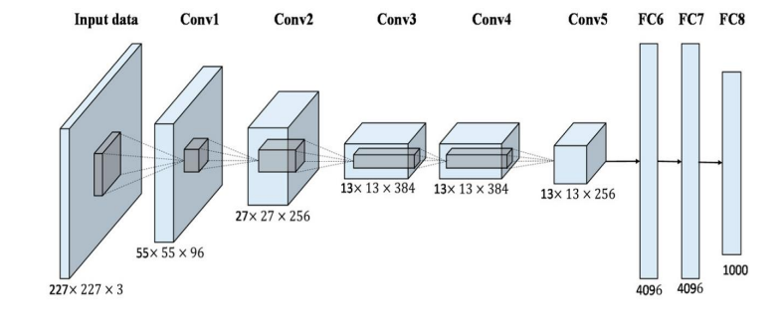
ALEXNET
AlexNet is a deep convolutional neural network (CNN) architecture that made a significant impact on the field of computer vision.
Layer 1: Convolutional layer with 96 filters of size 11x11 and stride of 4, followed by batch normalization and max pooling with a pool size of 3x3 and stride of 2.
Layer 2: Convolutional layer with 256 filters of size 5x5 and stride of 1, followed by batch normalization and max pooling with a pool size of 3x3 and stride of 2.
Layer3: Convolutional layer with 384 filters of size 3x3 and stride of 1, followed by batch normalization.
Layer 4: Convolutional layer with 384 filters of size 3x3 and stride of 1, followed by batch normalization.
Layer 5: Convolutional layer with 256 filters of size 3x3 and stride of 1, followed by batch normalization and max pooling with a pool size of 3x3 and stride of 2.
Layer 6: Flatten the output of layer 5 and add a fully connected layer with 4096 units and ReLU activation, followed by dropout regularization with a rate of 0.5.
Layer 7: Add another fully connected layer with 4096 units and ReLU activation, followed by dropout regularization with a rate of 0.5.
Layer 8: Add a final fully connected layer with 26 units (the number of output classes) and softmax activation.

Slide 23
ALEXNET WITH TRANSFER LEARNING
This code builds a convolutional neural network (CNN) based on the architecture of AlexNet and fine-tunes a pre-trained VGG16 model for image classification. The architecture of the model is as follows:
Layer 1: Convolutional layer with 96 filters of size 11x11 and stride of 4, followed by batch normalization and max pooling with a pool size of 3x3 and stride of 2.
Layer 2: Convolutional layer with 256 filters of size 5x5 and stride of 1, followed by batch normalization and max pooling with a pool size of 3x3 and stride of 2.
Layer3: Convolutional layer with 384 filters of size 3x3 and stride of 1, followed by batch normalization.
Layer 4: Convolutional layer with 384 filters of size 3x3 and stride of 1, followed by batch normalization.
Layer 5: Convolutional layer with 256 filters of size 3x3 and stride of 1, followed by batch normalization and max pooling with a pool size of 3x3 and stride of 2.
Layer 6: Flatten the output of layer 5 and add a fully connected layer with 4096 units and ReLU activation, followed by dropout regularization with a rate of 0.5.
Layer 7: Add another fully connected layer with 4096 units and ReLU activation, followed by dropout regularization with a rate of 0.5.
Layer 8: Add a final fully connected layer with 26 units (the number of output classes) and softmax activation.
The code then loads a pre-trained VGG16 model, freezes its layers so that they are not trainable, and appends some additional layers to the model for fine-tuning. Specifically, it adds a flatten layer to convert the output of the VGG16 model to a one-dimensional vector, followed by a fully connected layer with 256 units and ReLU activation, dropout regularization with a rate of 0.5, and a final fully connected layer with 26 units and softmax activation.

Slide 24
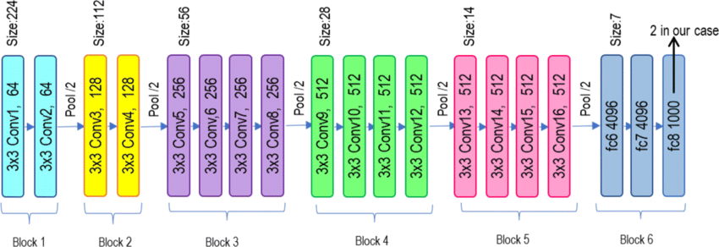
VGG19
The code is implementing the VGG19 architecture, which is a deep convolutional neural network that was first introduced in 2014. The VGG19 architecture is similar to the VGG16 architecture but has a deeper network with 19 layers.
The code first loads the pre-trained VGG19 model with the weights pre-trained on the ImageNet dataset. The include_top=False argument specifies that the fully connected layers at the top of the network should be excluded, leaving only the convolutional layers.
The next line creates a new input layer to replace the removed fully connected layers. The Flatten layer is used to flatten the output from the convolutional layers, and the Dense layer with 64 units and the ReLU activation function is added to provide additional learnable parameters and increase the complexity of the model. Finally, an output layer with 26 units is added to produce the final classification output.
The overall architecture of the VGG19 model is a deep convolutional neural network with 19 layers, consisting of alternating convolutional layers with 3x3 filters and max pooling layers with 2x2 filters. The fully connected layers at the top of the network are replaced with a single dense layer and an output layer with 26 units.

Slide 25
VGG19 WITH TRANSFER LEARNING
This model utilizes the VGG19 architecture with transfer learning. The pre-trained VGG19 layers are frozen, and two additional layers are added for fine-tuning the model for a specific task. The model consists of the following layers:
VGG19 base model with frozen weights.
Flatten layer to convert the output into a 1D tensor.
Fully connected layer with 1024 units and ReLU activation is added.
• Output layer with 26 units (output classes) and softmax activation is added. In both transfer learning models (AlexNet_TL and VGG19_TL), the pre-trained layers are frozen to retain their learned features from the ImageNet dataset. Only the additional layers introduced after the pre-trained base model are trained from scratch to adapt to a specific task or dataset.

Slide 26
Training Model

Slide 27
Training Model
The model is trained using the Adam optimizer, which is an algorithm used for stochastic gradient descent optimization. The optimizer is used to minimize the loss function during training by adjusting the weights of the neural network.
During training, the model is first compiled with the chosen optimizer, loss function (in this case, categorical cross-entropy), and evaluation metric (accuracy). Then, the training dataset is passed through the model in batches, and the optimizer updates the weights based on the calculated loss for each batch.
The training process is typically done over several epochs, with each epoch consisting of a full pass through the training dataset. During each epoch, the model is evaluated on the validation dataset to monitor its performance and prevent overfitting. The training is stopped when the validation loss stops improving.
As for the model's training and validation accuracy and loss curves, they would show how the model's performance improved over each epoch of training. Typically, the accuracy should increase and the loss should decrease with each epoch, indicating that the model is learning and improving its predictions. However, it's important to monitor the validation accuracy and loss as well, as they can provide insight into whether the model is overfitting to the training data.

Slide 28
Comparison of Models

Slide 29
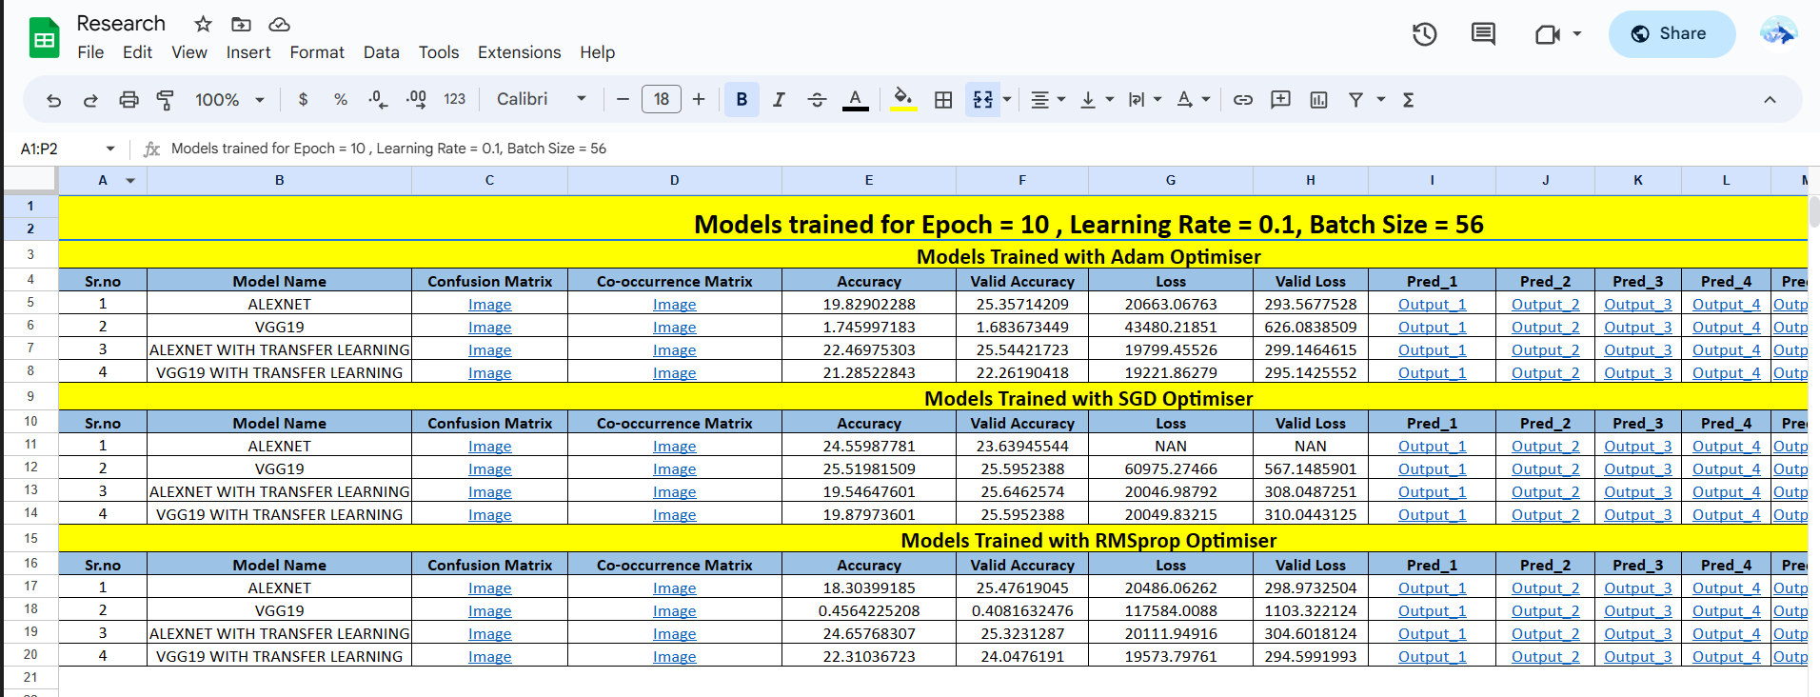
COMPARISON OF MODELS
All the models statistics like Confusion Matrix, Co-occurrence Matrix, Accuracy, Valid Accuracy, Loss, Valid Loss, 5 Outputs for every models are placed in excel sheet.
Models are run on 10 Epoch and 25 Epoch with different learning rate and 3 Optimizer.
Along with stats you can see the Kaggle code of our model and you can download the weights also.
Link: Google Sheets

Slide 30
Thank You !!

